Slide 1
Friends
of
Walkeringham Primary School
Annual General Meeting
12th March 2026

Slide 2
AGM 2024
Minutes of the Annual General Meeting held on (23.01.25)
Matters arising from the Minutes

Slide 3
WELCOME AND THANK YOU
The current charity trustees/committee members
  Jenny Ellson- Treasurer
  Ellen Armstrong- Secretary
  Lori Shemilt
Volunteers
  Louise Fahy
  Sarah Banton
  Kelly Taylor
And of course YOU

Slide 4
Chair’s report
External funding
YOR4Good funding for the EYFS playground £9958.59
Tesco Stronger Starts 24/25 £1500
Tesco Stronger Starts 25/26 £1500
Easter eggs from Tesco £20
Easy fundraising- 19 supporters so far. £144.89
Parish Council £330
Parents Lottery £9.37

Slide 5
Chair’s report
The decision-making process for spending funds.
Larger funds- the decision will be referred to the school
Smaller spending- committee

Slide 6
Chair’s report
How can you give your ideas and make the decision on what we spend the money we raise on?
Speak to us
Email us
Teachers
Staff meetings
School council

Slide 7
Chair’s report
Highlights of the PTA’s past year
New reading shelter
Conversion of the nature shelter
Minimise what we ask parents for.
  Contributed to external trips
    Fund 50% of the coach costs for 4 school trips
    Fund 100% of the cost of the coach for the pantomime and ice-creams
Activities are not always to raise funds.

Slide 8
Chair’s report
How the PTA has benefitted pupils at the school in the past year?
  Thought of new activities to generate interest and excitement
  Funded the coach and ice-creams at the pantomime
  Bought leaving gift for the year 6 student
  Bought selection boxes at Christmas
  Raised funds and bought Easter eggs for the Easter egg hunt

Slide 9
Chair’s report
How the PTA has worked with the local community in the past year?
Small local businesses have donated prizes to our raffles, although many businesses are struggling to donate.
The Parish Council generously donated funds and we have requested money for the coming year as well
Invited the local community to contribute
  Care home judged the Easter egg competition 2025

Slide 10
Chair’s report
Thanks to those who have supported your committee and the PTA.
Parents Children Teachers Family Community

Slide 11
New members
Would you like to……
Contribute to the school in a positive way
Enhance the children's education outside the current curriculum?
Can you…………….
Work as a team
Communicate well
Bring positivity and enthusiasm
We would love to hear from you!
Committee member Volunteer

Slide 12
Chair’s report
Plans for 2026
March - Egg drop challenge
May - Sponsored run
June - Summer Fayre
July - Leaver’s Celebration
Continuing the EYFS playground renovation
Redecorating the web

Slide 13
Treasurer’s report

Slide 14
Treasurers Report 1st January 2025-31st December 2025
Total amount raised over year: £12558.15
Starting Balance:
Petty Cash £669.38
Lloyds Bank Account £2070.44
Closing Balance:
Petty Cash 771.96
Lloyds Bank Account £10633.52

Slide 15
Fundraising
Total £12558.15
Event/Donation | Amount raised
Donation S&B company | £360
Donation Parent | £10
Easter Raffle | £237
Easter Competition | £23
Sale from soft play equipment at school | £40
Donation Pat Hooton | £20
Donation from C&B Company | £100
Break the rules day | £84.50
Summer Fayre and Raffle | £819.10
School Disco | £105.36
Bake off | £129.25
Halloween Disco | £122.90
Christmas Eve Boxes | £135
Christmas fayre | £207.20
Christmas cards-class fundraising | £40.60
Christmas Raffle | £237
Parentkind Asda | £90.37
Tesco reading shelter | £1125+£375
Walkeringham Parish Council | £330
East Riding of Yorkshire Grant | £7966.87

Slide 16
Amount spent
Total £569.04
Event | Cost
Parentkind subscription | £115
Easter prizes | £25.50
Service Charge Lloyds | £60.98
Summer Fayre/disco | £133.87
Lottery License | £40
Bake off prizes | £22.27
Halloween prizes/food | £51.73
Christmas fayre | £119.69

Slide 17
How the funds were put back into the school
Total £3287.50
Event | Cost
Coach trip (Unity) | £305
Easter eggs and prizes | £25.75
Reading Shelter-Collaborate | £1798.80
Coach-butterfly house | £395
Leavers Gift | £21.95
Coach-Bassetlaw Museum | £147.50
Panto Icecreams | £97.50
Coach Panto | £450
Selection Boxes | £46

Slide 18
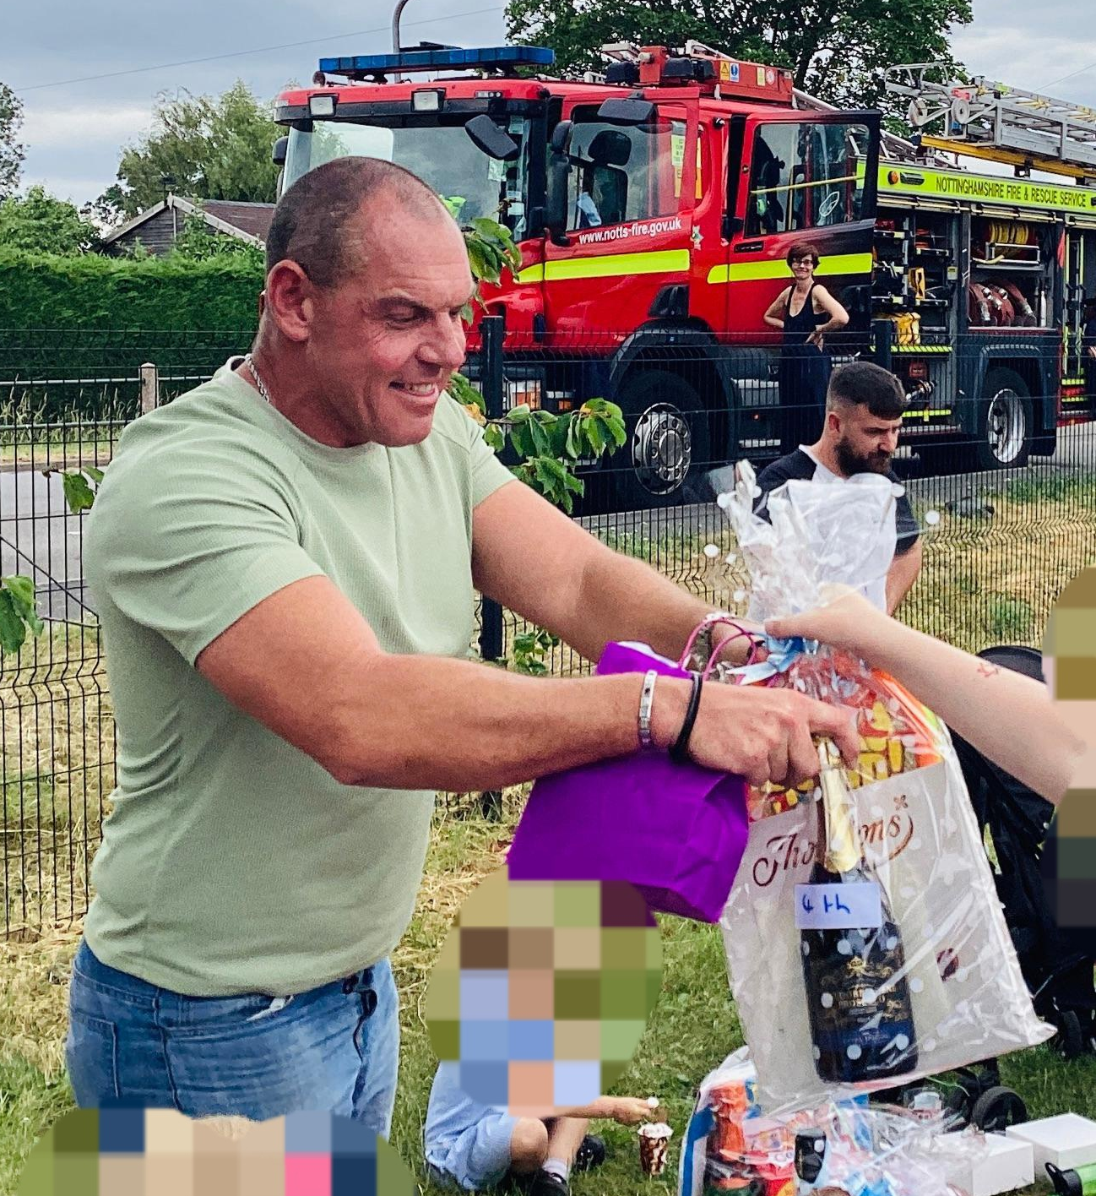
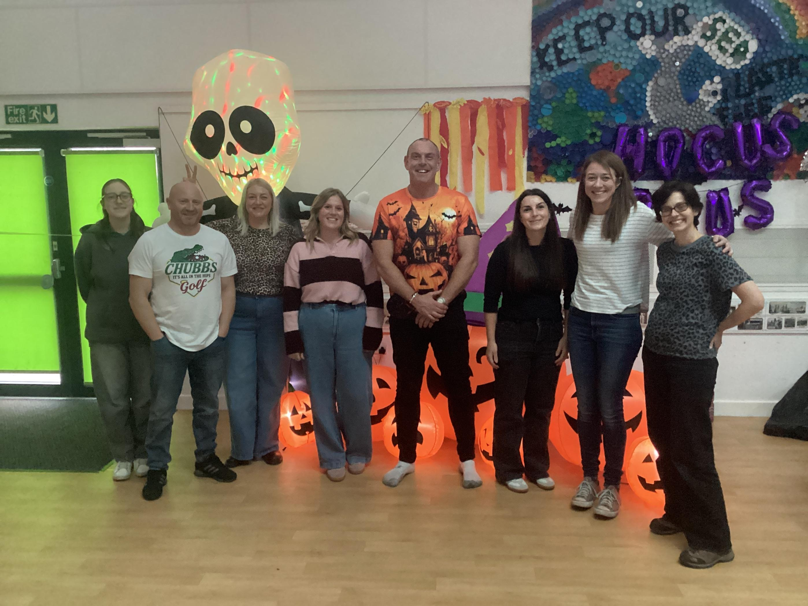
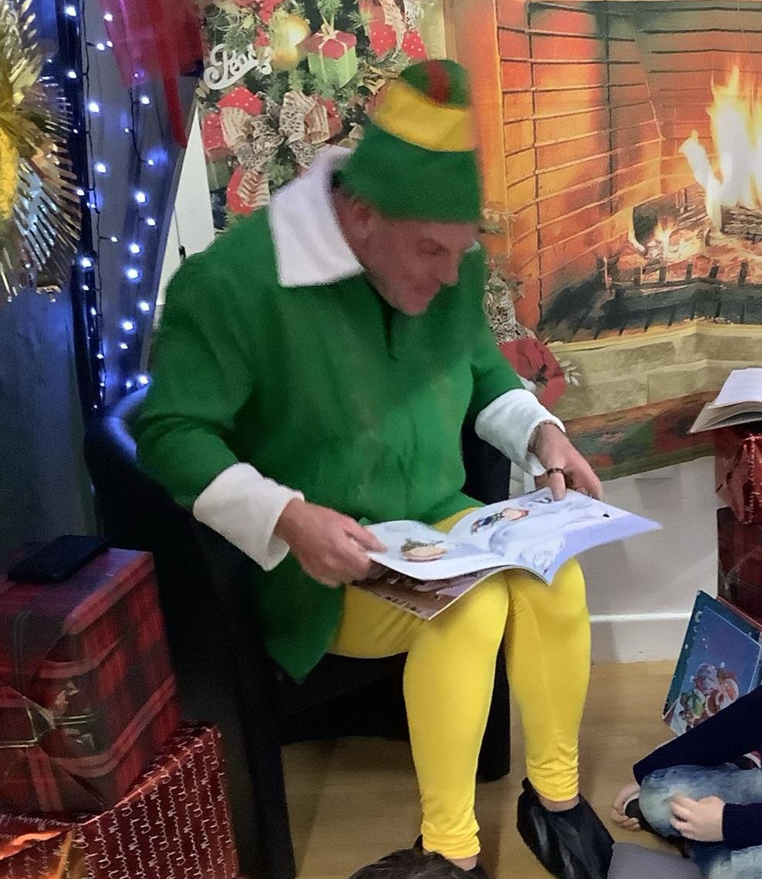
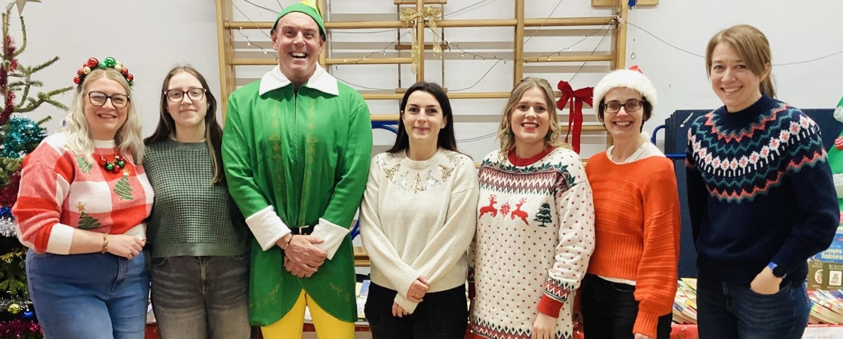
Mark

Slide 19
Any other business?

